Slide 1
File Management

Slide 2
File System Architecture
Field
Records
Files
Database

Slide 3
Field
Roll No. | Name | Address | Telephone | …….
865472 | Jhony | North East P. | 985647234 | ….
…. | ….. | ….. | ….. | …..
….. | ….. | ….. | ….. | …..
Record
FILE

Slide 4
File
File is a named collection of related information that is recorded on a secondary storage.
It made of fixed length logical records that allow programs to read and write records rapidly in no particular order.

Slide 5
File Concept
File system is the most visible aspect of an operating system.
It consists of 2 parts: collection of files(each storing related data) and a directory structure which organizes and provides all the information about all the files in your system.
File is the named collection of related information.
File is a sequence of bits, bytes, lines, or records, the meaning of which is defined by the file’s creator and user.
Commonly files represent programs(both source and object forms) and data.

Slide 6
File Attributes
Name – only information kept in human-readable form. Name is usually a string of characters such as example.c. some systems differentiate between upper case and lower case and some don’t.
Identifier – unique tag (number) identifies file within file system
Type – needed for systems that support different types
Location – pointer to file location on device
Size – current file size
Protection – controls who can do reading, writing, executing
Time, date, and user identification – data for protection, security, and usage monitoring
Information about files are kept in the directory structure, which is maintained on the disk

Slide 7
File Operations
File is an abstract data type. To define a file properly, we need to consider some operations which can be performed on files
Create
Write
Read
Reposition within file
Delete
Truncate
Open(F_{i}) – search the directory structure on disk for entry F_{i}, and move the content of entry to memory
Close (F_{i}) – move the content of entry F_{i} in memory to directory structure on disk

Slide 8
File Structure
Internal File Structure
External File structure
Operating system provides various file structures for managing files.
Also provides set of special operations for manipulating files with these file structures.

Slide 9
Access Methods
Files store information and this information must be accessed and read into computer memory.
The information in the file can be accessed in several ways.

Slide 10
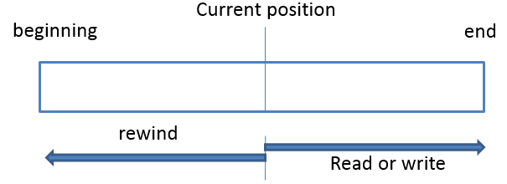
Sequential Access
Information is processed on one order, one record after the other.
A read operation—read next—reads the next portion of the file and automatically advances a file pointer, which tracks the I/O location. Similarly, the write operation—write next—appends to the end of the file and advances to the end of the newly written material (the new end of file).

Slide 11
Direct Access
In direct access file is seen as a numbered sequence of blocks or records.
Immediate access to large amount of information.
The operations include:
read n, where n is the block number, rather than read next.
write n, where n is the block number, rather than write next.
position to n, where n is the block number.

Slide 12
n = relative block number
Sequential Access
read next
write next
reset
Direct Access
read n
write n
position to n
read next
write next

Slide 13
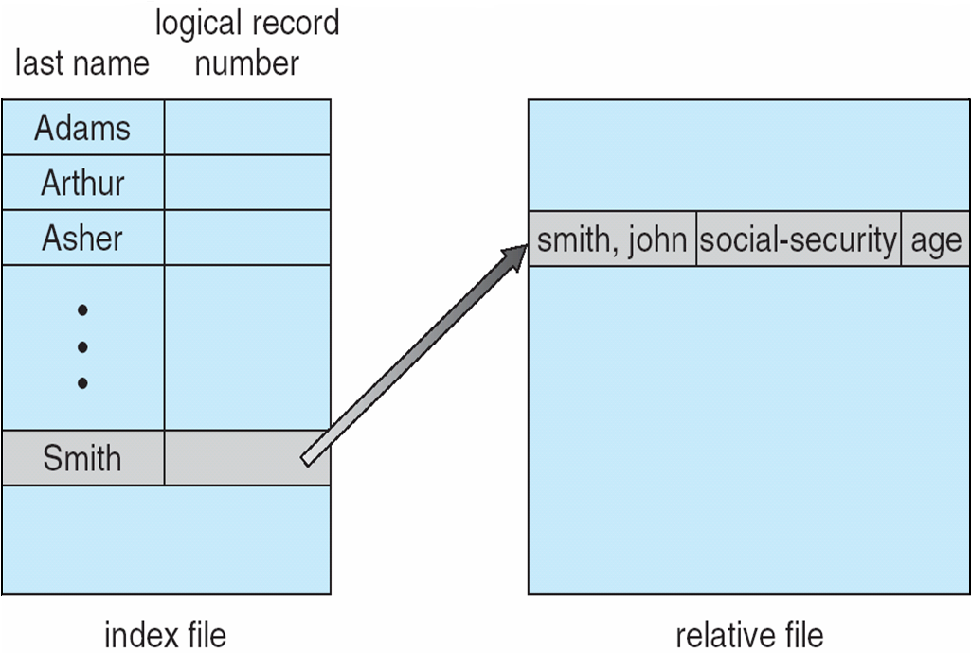
Indexed Access Method
An index is associated with the file containing pointers to the blocks.
To find the record in the file, we search the index and then use the pointer to access the file directly and to find the desired record.

Slide 14
Disk Structure
As the number of files increase the issue of managing the files becomes an issue.
The organization is done in two parts, Firstly:
Disk can be subdivided into partitions
Disks or partitions can be RAID protected against failure
Disk or partition can be formatted with a file system
Partitions also known as minidisks, slices or volume
Secondly, Each volume containing file system also tracks that file system’s info in device directory or volume table of contents.

Slide 15
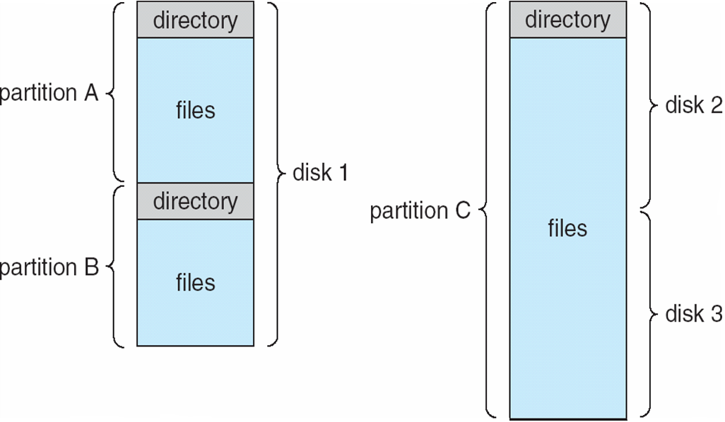
A Typical File-system Organization

Slide 16
Operations Performed on Directory
Search for a file
Create a file
Delete a file
List a directory
Rename a file
Traverse the file system

Slide 17
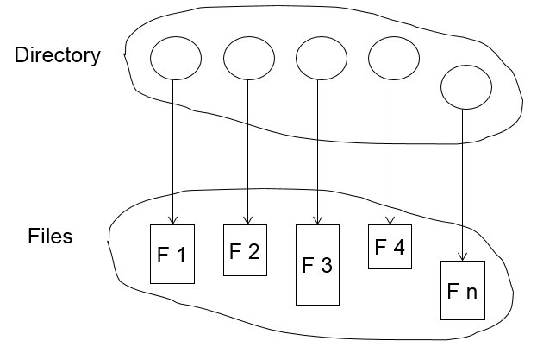
Directory Structure
The directory contains information for all files.
Both the directory structure and the files reside on disk

Slide 18
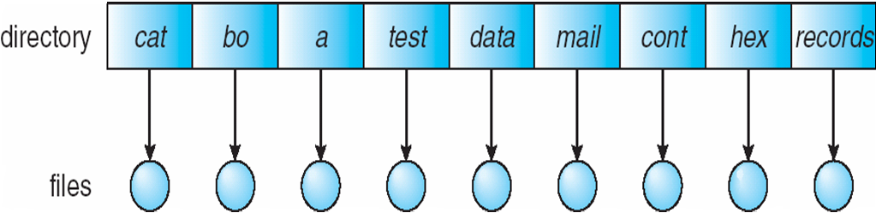
Single-Level Directory
A single directory for all users
Easy to support and understand.
Limitation:
When number of files increases or when the system has more than one user, then Naming problem occurs. All files should have unique names.

Slide 19
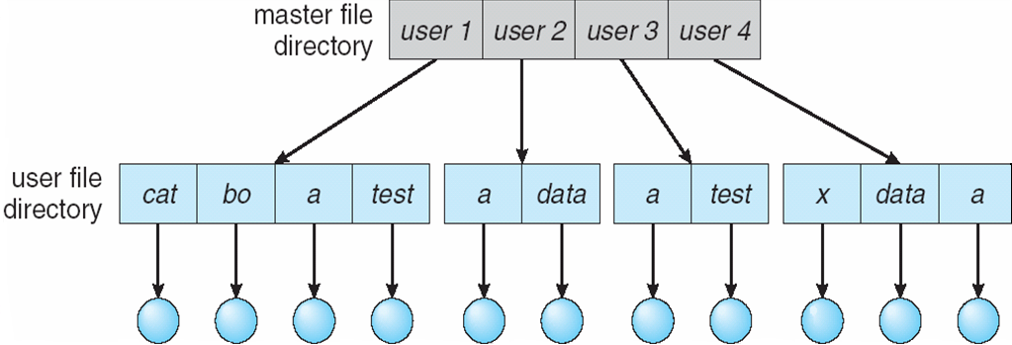
Two-Level Directory
In two level directory, each user has his own user file directory(UFD). UFDs have the similar structure, but each lists only the files of a single user.
Path name
Can have the same file name for different user
Efficient searching

Slide 20
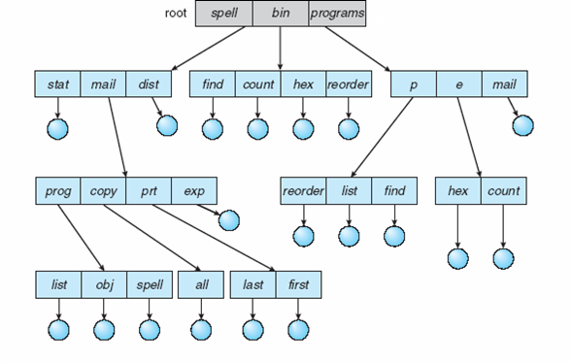
Tree-Structured Directories

Slide 21
Tree-Structured Directories (Cont)
Absolute or relative path name
Creating a new file is done in current directory
Delete a file
rm <file-name>
Creating a new subdirectory is done in current directory
mkdir <dir-name>
Example: if in current directory /mail
mkdir count
mail
prog
copy
prt
exp
count
Deleting “mail” ⇒ deleting the entire subtree rooted by “mail”

Slide 22
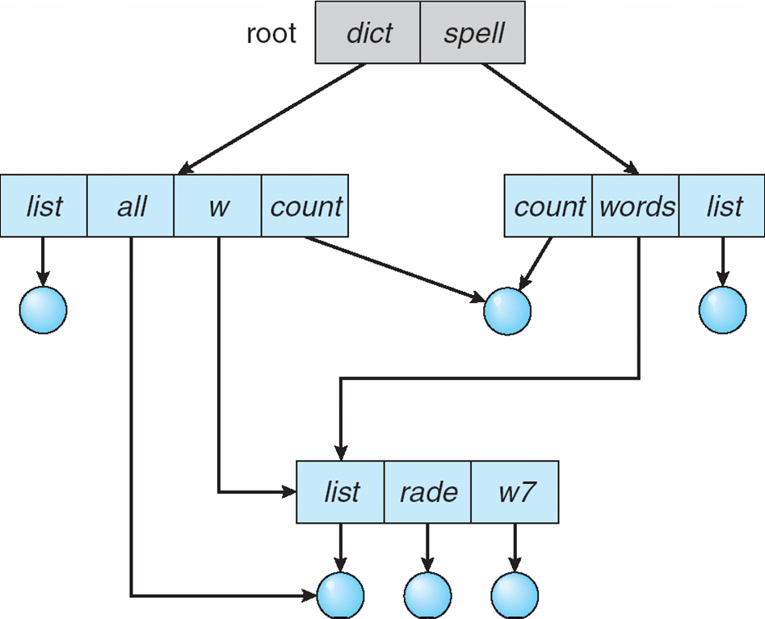
Acyclic-Graph Directories
Have shared subdirectories and files

Slide 23
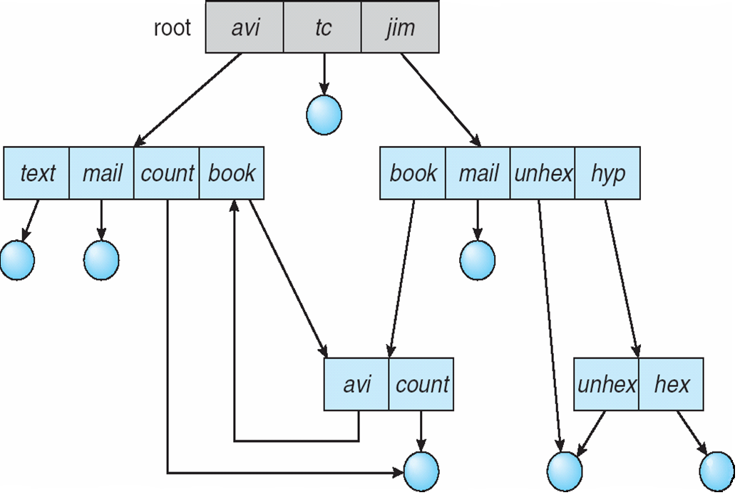
General Graph Directory

Slide 24
Directory Implementation
Linear List
Simple to program
Time consuming to execute
Create new file
Make sure it’s a unique file name
Add entry at end of directory
Delete a file
Search for the file
Release the space allocated to it
Mark the space as unused or attach it to list of free directory entries or copy the last directory entry here.

Slide 25
2. Hash Table
Linear list + hash structure
Compute hash value of file names and returns pointer to file in the linear list
Decreases search time
Collisions are to be avoided in case two file names hash to same location
Disadvantage – hash functions are of fixed size (0-64 or 0-128 etc)
Solution: a chained overflow hash table can be used.Each hash entry can be linked instead of an individual value and we can resolve collisions by adding the new entry to link list

Slide 26
Allocation Methods
An allocation method refers to how disk blocks are allocated for files so that disk space is utilized effectively and files can be accessed quickly.
Contiguous allocation
Linked allocation
Indexed allocation

Slide 27
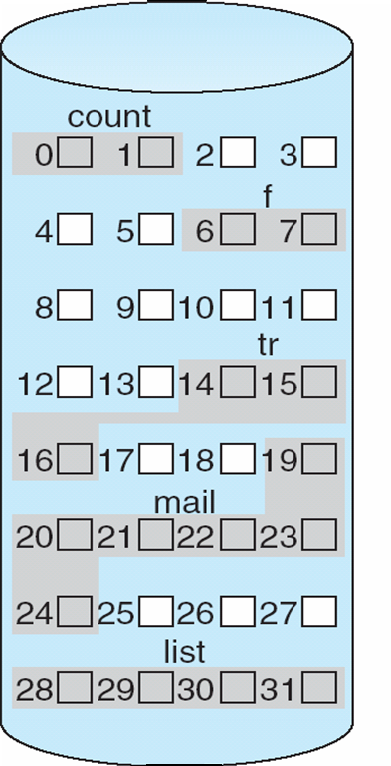
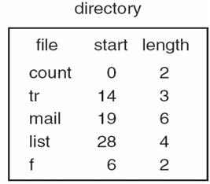
Allocation Methods
Contiguous Allocation
File occupy contiguous blocks
Directory entry contains
File name
Starting block
Length (total blocks)
Access possible
Sequential
Direct
Problems
Finding space for new file
External fragmentation
Determining space requirement of a file

Slide 28
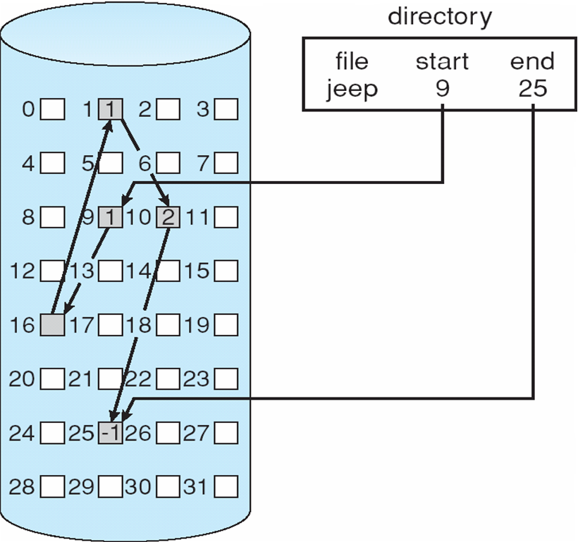
Linked Allocation
Directory structure contains
Pointer to first and last block of file
Advantages
No external fragmentation
No issue with increase in file size
Disadvantages
Only sequential access
Reliability – loss of a pointer
Space required for pointers
Solution: make cluster of blocks
Problem: internal fragmentation

Slide 29
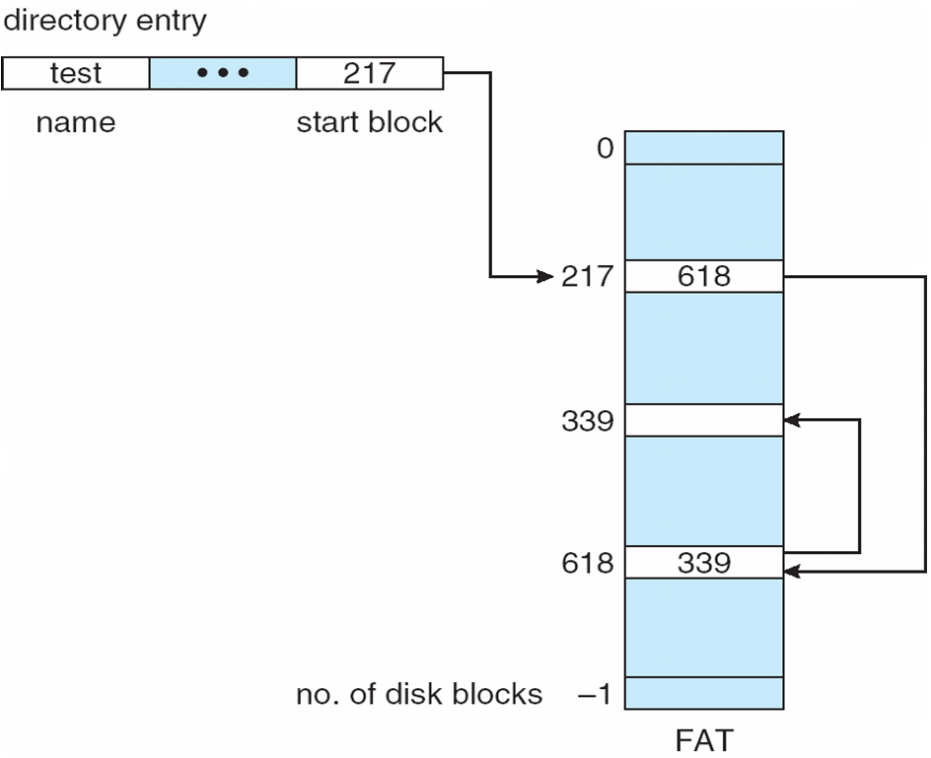
Example - FAT

Slide 30
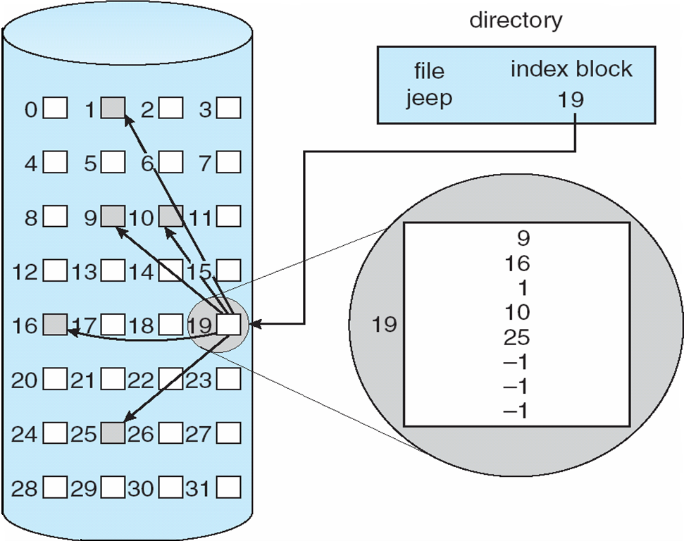
Indexed Allocation
Clubs all the pointers into one block – index block
Directory entry contains
File name
Index block number
Access
Direct
Issue
Size of index block
Sol: multilevel indexing

Slide 31
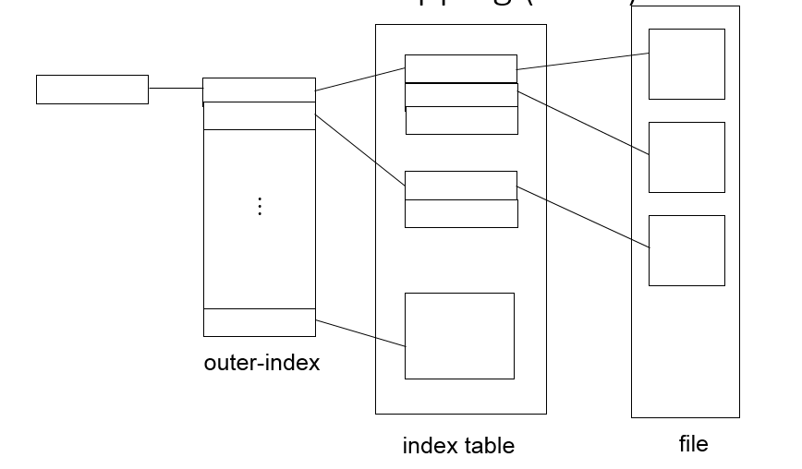
Indexed Allocation – Mapping (Cont.)

Slide 32
Performance
Contiguous
Requires only 1 access to get a disk block
Linked
Requires i disk reads to read i^{th} block
Indexed
Depends on
level of indexing
Size of file
Position of desired block

Slide 33
Free Space management
Disk space is limited, the space from deleted files is reused for new files, if possible. To keep track of free disk space, the system maintains a free-space list.
Bit vector
Linked list
Grouping
Counting

Slide 34
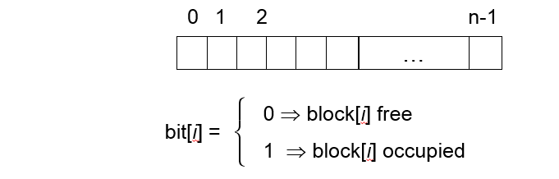
Bit Vector
The free-space list is implemented as a bit map or bit vector. Each block is represented by 1 bit. If the block is free, the bit is 1; if the block is allocated, the bit is 0.

Slide 35
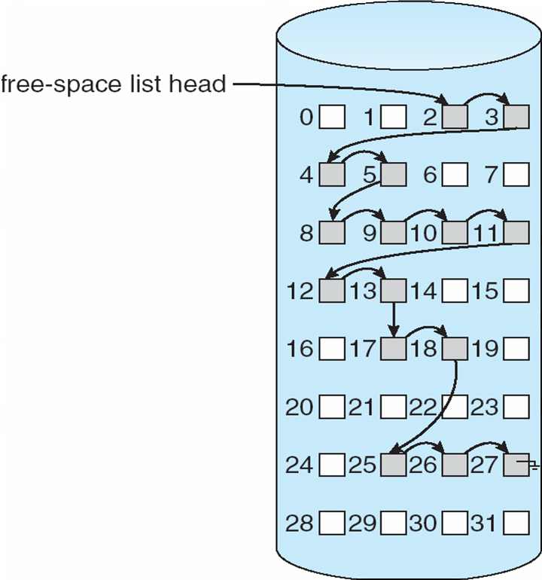
Linked List
Link together all the free disk blocks, keeping a pointer to the first free block in a special location on the disk and caching it in memory.

Slide 36
Grouping
Store the addresses of n free blocks in the first free block.
The first n—1 of these blocks are actually free.
The last block contains the addresses of another n free blocks, and so on.

Slide 37
Counting
Keep the address of the first free block and the number n of free contiguous blocks that follow the first block.
Each entry in the free-space list then consists of a disk address and a count.
Each entry requires more space than would a simple disk address, overall list will be shorter, as long as the count is generally greater than 1.

Slide 38
Summary
Files
File Structure
Access Methods
Directory Structure
Directory Implementation
Allocation Methods
Free Space Management

